Slide 1
Human Resource Management
MBA
Dr. Sumagna Bhowmick

Slide 2
Reflect
In organizations, people are mainly
A. A cost to be controlled
B. An asset to be developed
Notes:
Some of you see people as expenses that affect profitability. Others see people as value creators. Many of you say ‘it depends

Slide 3
Hard Vs Soft HRM
Hard HRM | Soft HRM
Management controls headcount, monitors numbers, and ensures that both numbers and performance meet organizational requirements. | Focuses on eliciting employee commitment so that behavior is largely self-regulated.
Quantitative and calculative work system | High-commitment work system
What will they emphasize upon? | What will they emphasize upon?
As future managers or HR professionals, where do you think the line should be drawn?
Notes:
Every topic in this course, recruitment, performance appraisal, rewards, layoffs, will sit somewhere between Hard and Soft HRM

Slide 4
So, what is HRM?
Given this discussion, how would you define HRM?
Notes:
Balancing costs and people”
Designing systems to manage people fairly
Aligning business needs and human need

Slide 5
What is HRM?
The process of acquiring, training, appraising, and compensating employees, and of attending to their labor relations, health and safety, and fairness concerns
Notes:
HRM operates on the “people” dimension of an organization.
Its function comprises anchoring the system’s processes and practices for acquiring, developing, and motivating people for performance and engaging them for achieving the objectives of the organization.
This is valid for all organizations irrespective of their nature, government, business, education, health, recreation, or social action

Slide 6
Competing definitions of HRM
Author & Year | Definition of HRM | Core Emphasis
Graham (1978) | To ensure that the employees of an organization are used in such a way that the employer obtains the greatest possible benefit from their abilities, and the employees obtain both material and psychological rewards from their work. | Utilization of employee abilities; mutual benefit with strong employer focus
Bratton & Gold (2007) | A strategic approach to managing employment relations which emphasizes that leveraging people’s capabilities is critical to achieving competitive advantage, achieved through a distinctive set of integrated employment policies, programmes, and practices. | Strategic HRM; alignment of HR practices with competitive advantage
Armstrong (2008) | A strategic and coherent approach to the management of an organization’s most valued assets—the people working there who individually and collectively contribute to the achievement of its objectives. | People as assets; collective contribution to organizational goals
Brewster, Mayrhofer & Morley (2016) | Human Resource Management refers to the management of people in organizations in a way that is strategic, coherent, and sensitive to context, recognizing employees as key contributors to organizational performance. | People as assets + strategy + organizational and institutional context
What shifts across these definitions, and what clearly does not change?
Notes:
From people as tools → people whose abilities are used (Graham)
To people as assets → sources of value and advantage (Armstrong)
To people as strategic contributors → aligned with competitive goals (Bratton & Gold)
To people in context → shaped by institutions, culture, and systems (Brewster et al.)
What does not change is that HRM is always about managing people for organizational ends

Slide 7
HRM Today: Responding to AI-Driven Change
Will AI Replace People? What Does This Mean for HRM?
Notes:
AI is unlikely to completely replace people in organizations. Instead, it reshapes the kinds of skills that are valued and required at work. People therefore remain central to organizations, even in an AI-driven context. What changes is not the presence of people, but the way organizations choose to manage them.
Organizations may respond to AI in different ways. Some may adopt a Hard HRM approach, where employees whose skills no longer align with organizational needs are exited, and new talent with AI-relevant skills is hired. Other organizations may adopt a Soft HRM approach, where existing employees are treated as long-term assets and are reskilled or upskilled to adapt to AI-related changes.
Thus, AI does not eliminate people from organizations; rather, it highlights different HRM philosophies and strategic choices in managing people.

Slide 8
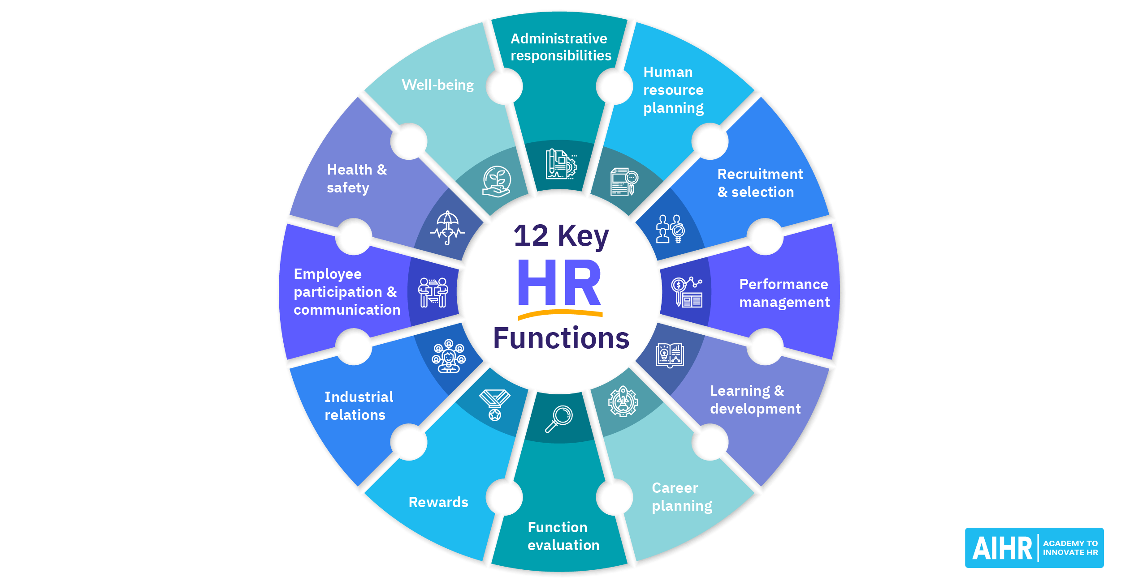
Scope of HRM - It covers the entire employee lifecycle—from entry to exit

Slide 9
Emerging Trends in HRM
Trend | Description | HRM Implication
Integration of Technology & AI | Use of digital tools and AI in HR processes like recruitment, performance analytics, and employee support. | HR functions shift from administrative tasks to strategic decision support.
Remote and Hybrid Work | Work continues to be distributed across remote and office settings. | HR must redesign policies on engagement, communication, hybrid teams.
Employee Experience & Well-Being | Focus on holistic employee experience, mental health, and work–life balance. | Greater emphasis on support systems, surveys, well-being programs.
Upskilling and Reskilling | Continuous learning to match evolving skill needs, especially with automation. | HR designs personalized learning journeys, internal mobility support.
Data-Driven HR & People Analytics | Use of analytics to predict turnover, optimize hiring, and guide talent decisions. | HR becomes more evidence-based with predictive insights.
Diversity, Equity & Inclusion (DEI) | Systematic strategies to promote fair representation and belonging. | HR incorporates inclusive hiring, bias mitigation, DEI metrics.
Strategic Workforce Planning | Shift from role-based to skill-based workforce design. | HR contributes directly to organizational strategy and future workforce needs.

Slide 10
Key Challenges for HRM
Area of Change | HRM Challenge
Remote & Hybrid Work | Sustaining engagement, trust, and accountability without excessive monitoring
AI as a Co-Worker | Managing skill displacement, reskilling decisions, and ethical use of AI
Changing Work Behaviours | Addressing disengagement (quiet quitting, no-shows, ghosting) without mislabeling employees
Employee Well-being & Mental Health | Preventing burnout, presenteeism, and digital overload
Upskilling & Reskilling | Deciding who to invest in, at what cost, and with what returns
Data-Driven HR & Surveillance | Balancing analytics with privacy, trust, and fairness
Retention & Commitment | Managing declining loyalty and increasing job-hopping
Diversity, Equity & Inclusion | Moving from symbolic initiatives to meaningful, measurable change

Slide 11
Reflect
If HR designs the system, but managers implement it, who really manages people?
Notes:
Everything we’ve discussed so far sounds like the job of HR. But most people don’t experience HR every day, they experience their manager

Slide 12
Why HRM Is Important to All Managers?
Managers get results through people Organizational goals are achieved through employees’ effort, motivation, and performance, not by managers alone.
HR systems work through managers Recruitment, appraisal, rewards, and feedback systems are designed by HR but enacted by managers in daily practice.
In many contexts, managers are HR Especially in small firms, startups, and line functions, managers directly handle hiring, performance, conflict, and exits.

Slide 13
HR as a Profit Center
A mid-sized services firm was facing declining margins despite steady revenue growth. Senior management initially blamed market competition and rising costs. Instead of cutting headcount, the HR team analyzed project data and employee skill utilization.
They discovered that a significant portion of project delays and cost overruns were due to poor skill matching and high early attrition among new hires. HR redesigned the recruitment process, introduced structured onboarding, and partnered with line managers to create targeted reskilling programs.
Within a year:
project turnaround time improved,
attrition in the first year dropped significantly,
client satisfaction increased, and
the firm reduced its reliance on expensive external consultants.
The CFO later noted that the improvement in margins came not from cost cutting, but from better people decisions.
If HR decisions directly improve margins and reduce losses, should HR still be seen only as a cost center
Notes:
HR should not be judged only as a cost center when its decisions demonstrably affect organizational performance. However, HR becomes a value-creating function only when it can link people decisions to business outcome
Can you think of one HR decision that, if done badly, would directly reduce profits?

Slide 14
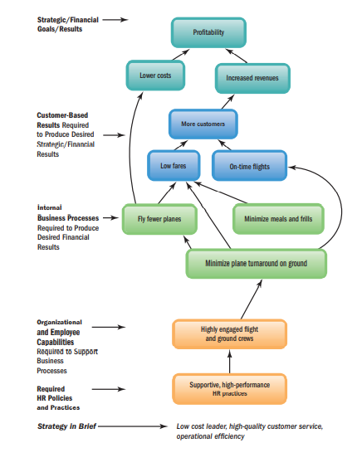
Strategic HRM
Strategy → Processes → Capabilities → HR Practices → Results
Notes:
Training, hiring, or engagement initiatives do not create value on their own. They create value only when they support what the organization is trying to achieve

Slide 15
Factors affecting HRM
Category | Factor | How It Affects HRM
Internal Factors | Organizational Strategy | Determines workforce size, skills required, performance systems, and reward structures
 | Organizational Culture | Shapes leadership style, employee relations, communication, and engagement practices
 | Organizational Structure | Influences roles, authority, reporting relationships, and HR coordination
 | Top Management Philosophy | Affects emphasis on Hard vs Soft HRM, investment in people, and HR priorities
 | Nature of Work & Technology | Determines job design, skill requirements, training needs, and work intensity
 | Workforce Characteristics | Age, gender, skill levels, and diversity influence HR policies and practices
External Factors | Economic Environment | Impacts hiring, layoffs, compensation levels, and job security
 | Labour Market Conditions | Availability of talent affects recruitment strategies and wage levels
 | Legal & Regulatory Framework | Determines compliance requirements related to wages, safety, diversity, and employment rights
 | Technological Changes | Drives reskilling, automation, HR digitalization, and AI use in HRM
 | Social & Cultural Factors | Influence employee expectations, work values, and HR norms
 | Trade Unions & Employee Associations | Affect collective bargaining, grievance handling, and employee relations
 | Globalization | Leads to cross-cultural HRM, global staffing, and international labour practices

Slide 16
HR Manager’s competencies
Competency Category | Core Competencies | What This Means in Practice
Leadership Competencies | • Navigation • Ability to direct and contribute to initiatives • Ethical practice & DEI | Guiding the organization through change, aligning HR initiatives with strategy, and ensuring ethical, inclusive decision-making
Relationship Competencies | • Communication • Global mindset • Relationship management | Building trust with employees and managers, managing diverse workforces, and handling conflict and collaboration effectively
Business Competencies | • Business acumen • Consultation • Analytical aptitude | Understanding the business context, advising managers on people decisions, and using data to support HR decisions

Slide 17
Reflect and Wrap-up
By calling these ‘HR manager competencies’, are we implying that line managers don’t need them, or that people management can be outsourced to HR?
When employee discontent at IndiGo became public, was it merely a crisis or a failure of leadership to understand and respond to its people concerns?
Notes:
The IndiGo case shows that HRM failures often stem from leadership oversight. When leaders overlook people concerns, HRM turns from a strategic asset into a serious liability.

